Slide 1


XGBoost Algorithm
INFO-523
Submitted By
Gayathri Renganathan, Mohit Rakesh Taparia

Slide 2
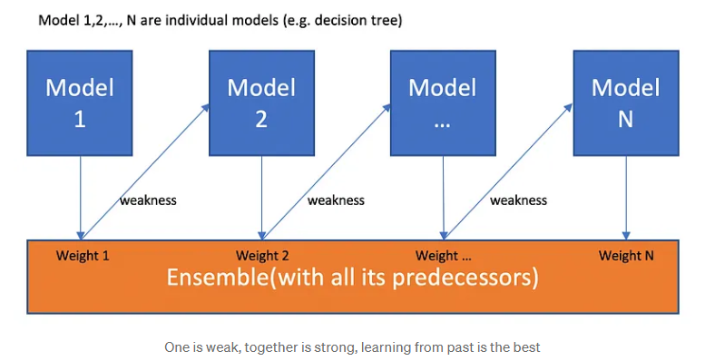
XGBoost
XGBoost, or eXtreme Gradient Boosting, is a machine learning algorithm under ensemble learning.
Supervised Learning Model for both Regression and Classification.

Slide 3
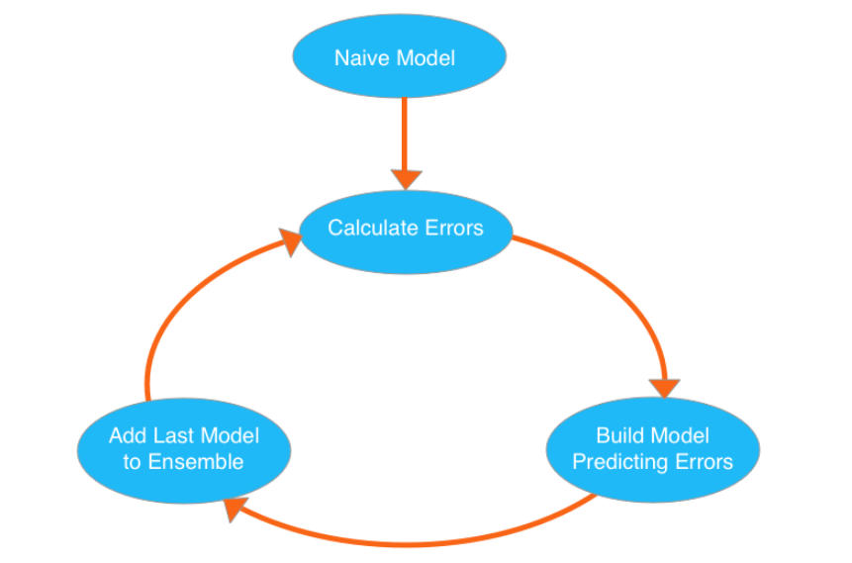
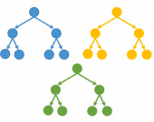
Boosting – Ensemble Learning
Boosting is an ensemble modelling, technique that attempts to build a strong classifier from the number of weak classifiers.
Gradient boosting combines the predictions of multiple weak learners sequentially
Gradient Boosting is a popular boosting algorithm. In gradient boosting, each predictor corrects its predecessor’s error. In contrast to Adaboost, the weights of the training instances are not tweaked, instead, each predictor is trained using the residual errors of predecessor as labels.

Slide 4


Why XGBoost ?
Optimized distributed gradient boosting library designed for efficient and scalable training of machine learning models.
Key Features:
Scalability to handle large datasets
Sparsity Awareness - Efficient handling of missing values
Built-in support for parallel processing
Weighted Quantile Sketch
Faster execution speed
Includes Regularization to control overfitting
Improved Model performance in both classification and regression
Built-in cross-validation method to prevent overfitting
Provides Feature Importance, for easy interpretation

Slide 5
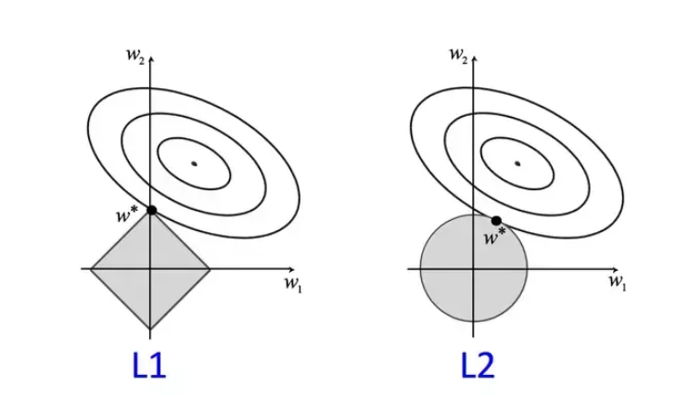
Regularization
Incorporates L1 and L2 Regularization to avoid overfitting.

Slide 6
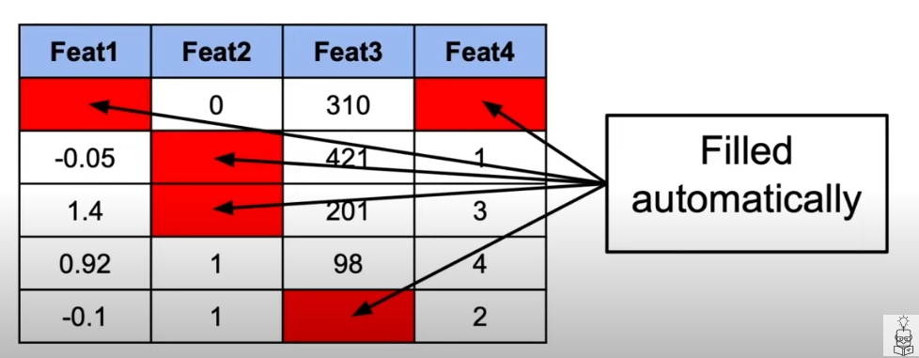
Sparsity Awareness
Missing values in dataset are filled automatically

Slide 7
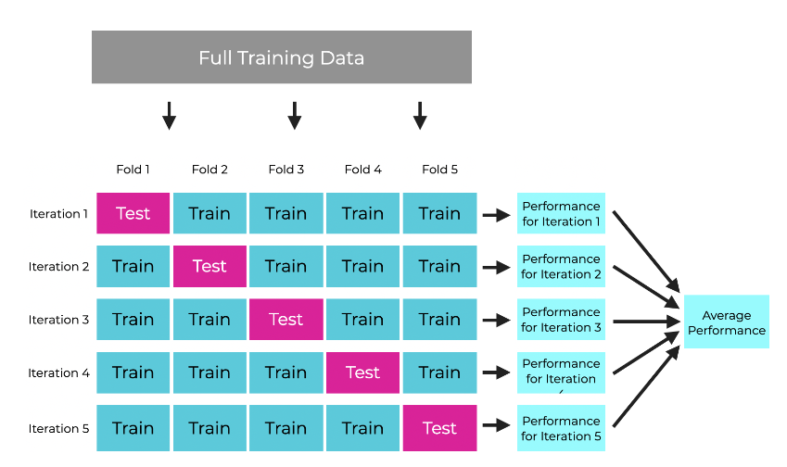
Cross - Validation
Dataset is split in to K folds
Each iteration, model is trained on K-1 fold and tested on the remaining fold.
Average results across all the iterations.

Slide 8
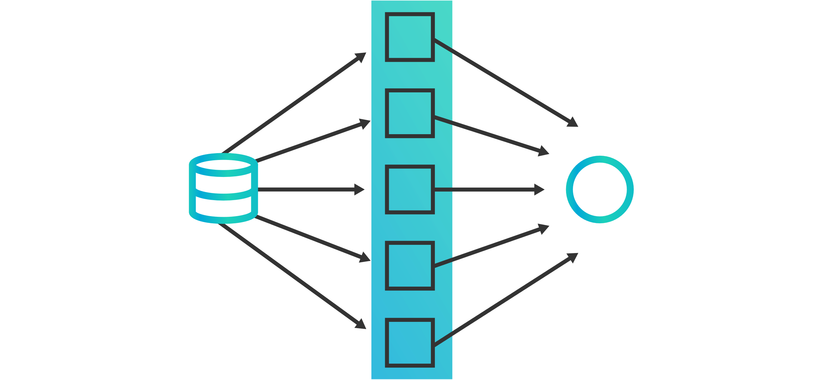
Parallelization
Efficiently utilizes multi-core, distributed computer framework for handling large dataset
Higher computation speed

Slide 9
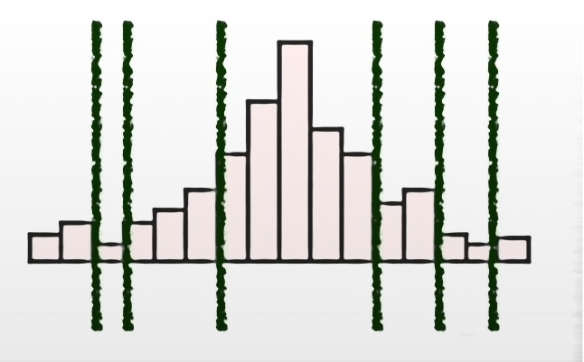
Weighted Quantile Sketch
Find effective split points in large datasets
Every quantile won’t necessarily have the same number of samples

Slide 10

Case Study
Telecom customer churn dataset: https://archive.ics.uci.edu/dataset/563/iranian+churn+dataset
Analyze Telecom customer churn using XGBoost Algorithm
Github Repo:
https://github.com/GayathriRenganathan/Data-Mining-Project

Slide 11
Data preprocessing
Scaling & Encoding
Missing Data
Collinearity
Cleaned Dataset
Preprocessing:
Handled missing data
One hot encoding categorical values
Removed collinearity
Feature scaling
Removed unnecessary columns

Slide 12
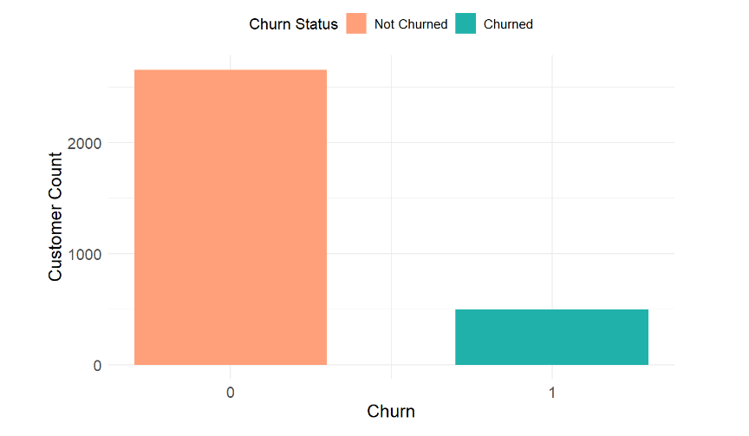
Distribution of Customer Churn
2655
Inference:
The dataset has imbalance across Customer Churn label. Customers who got churned has less records compared to customers did not get churned
495

Slide 13
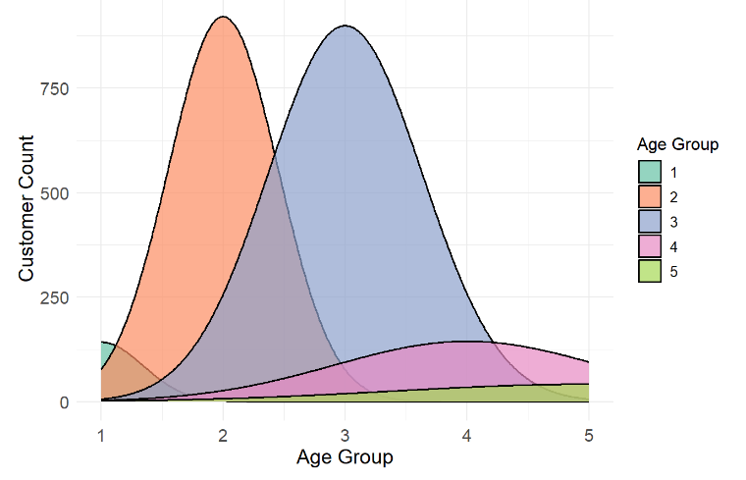
Age Group Distribution
Inference:
More Customers are in the age group bucket of 2 and 3 (Middle Aged)
(0-19)
(20-29)
(30-39)
(40-49)
(50+)

Slide 14
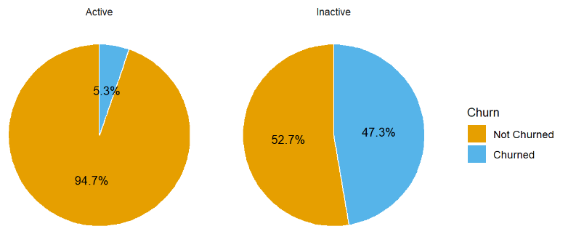
Distribution of Customer Churn across Status
Inference:
Close to 50% of inactive customers are churned

Slide 15
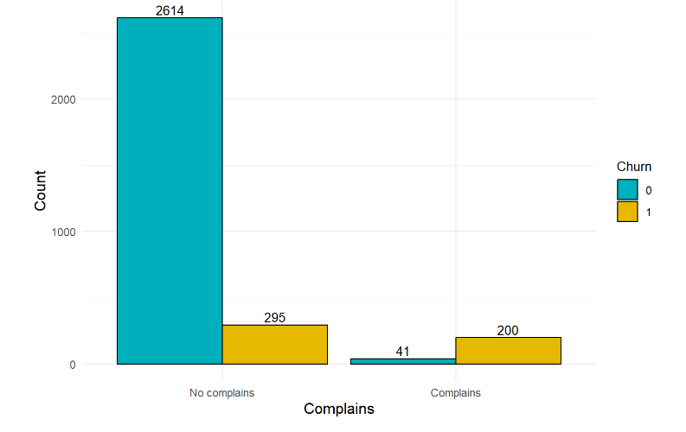
Customer Churn vs Complains
Inference:
Customers who have raised complains are likely to be churned

Slide 16
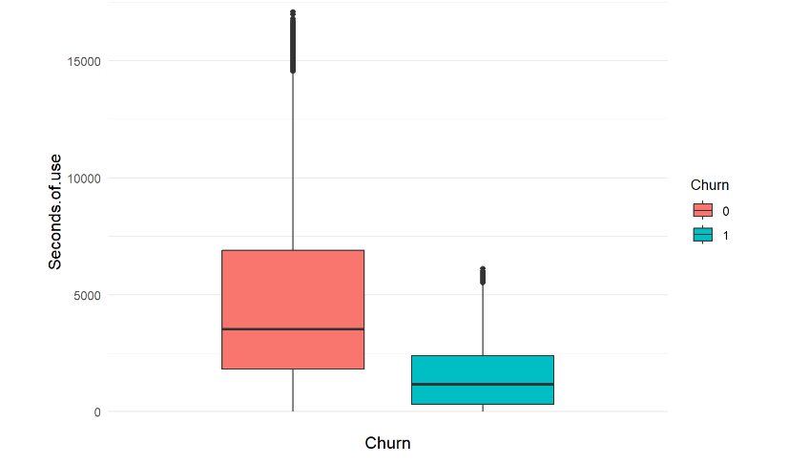
Customer Churn vs Seconds of use
Inference:
Customer with lesser usage are more prone to be churned

Slide 17
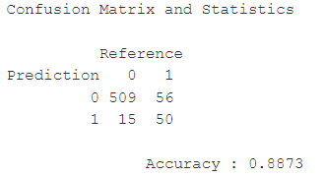
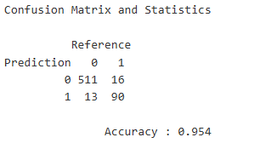
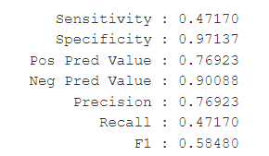
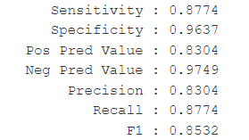
Performance metrics
Logistic Regression
XgBoost
Inference:
Performance is improved drastically with the XgBoost Algorithm
7.5% increase in Accuracy score
45% increase in F1 Score

Slide 18
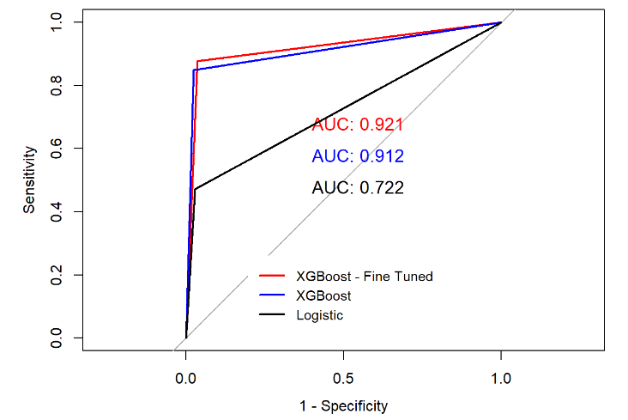
ROC Curve Comparison
Inference:
Hyperparameter tuning increasing model performance
AUC is increased from 0.722 to 0.921 using XGBoost

Slide 19
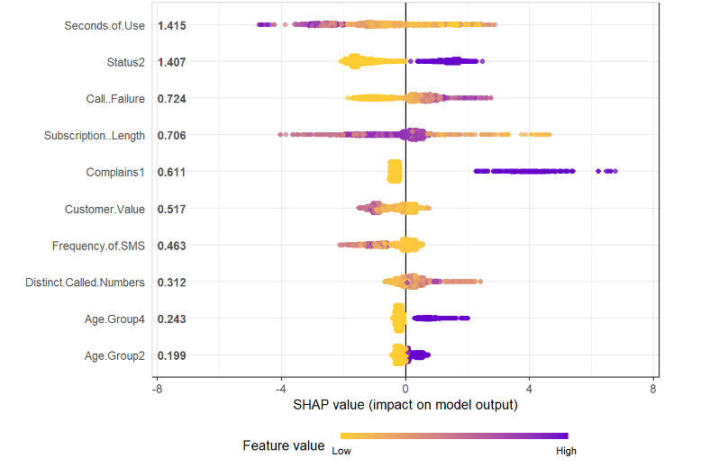
Feature Importance - SHAP
Inference:
Customer with less seconds of use are likely to be churned.
Inactive Customers are likely to be churned.
Call Failure also contributes to customer churn.
Customers with complains are getting churned.
Customers with Less subscription length are churned

Slide 20

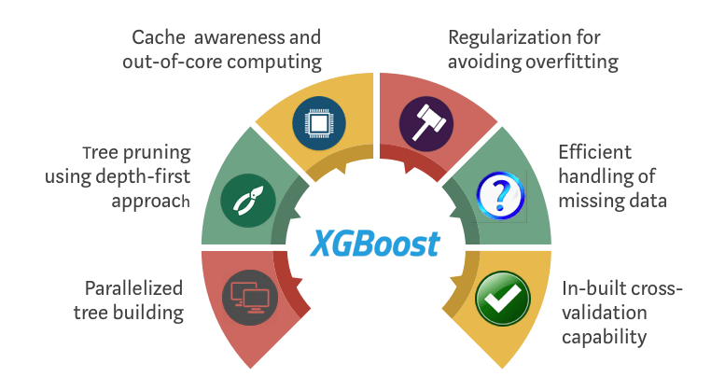



Conclusion
XGBoost is a versatile and powerful ensemble algorithm
Capable of handling large datasets with high accuracy and efficiency.
Its range of features includes regularization, sparsity awareness, parallel processing, and advanced techniques like the Weighted Quantile Sketch, make it an invaluable tool for data scientists
XGBoost offers the performance and scalability needed to tackle the complex data analysis task.

Slide 21

Thank you
For queries, please reach us at grenganathan@arizona.edu, mohittaparia@arizona.edu

